Slide 1
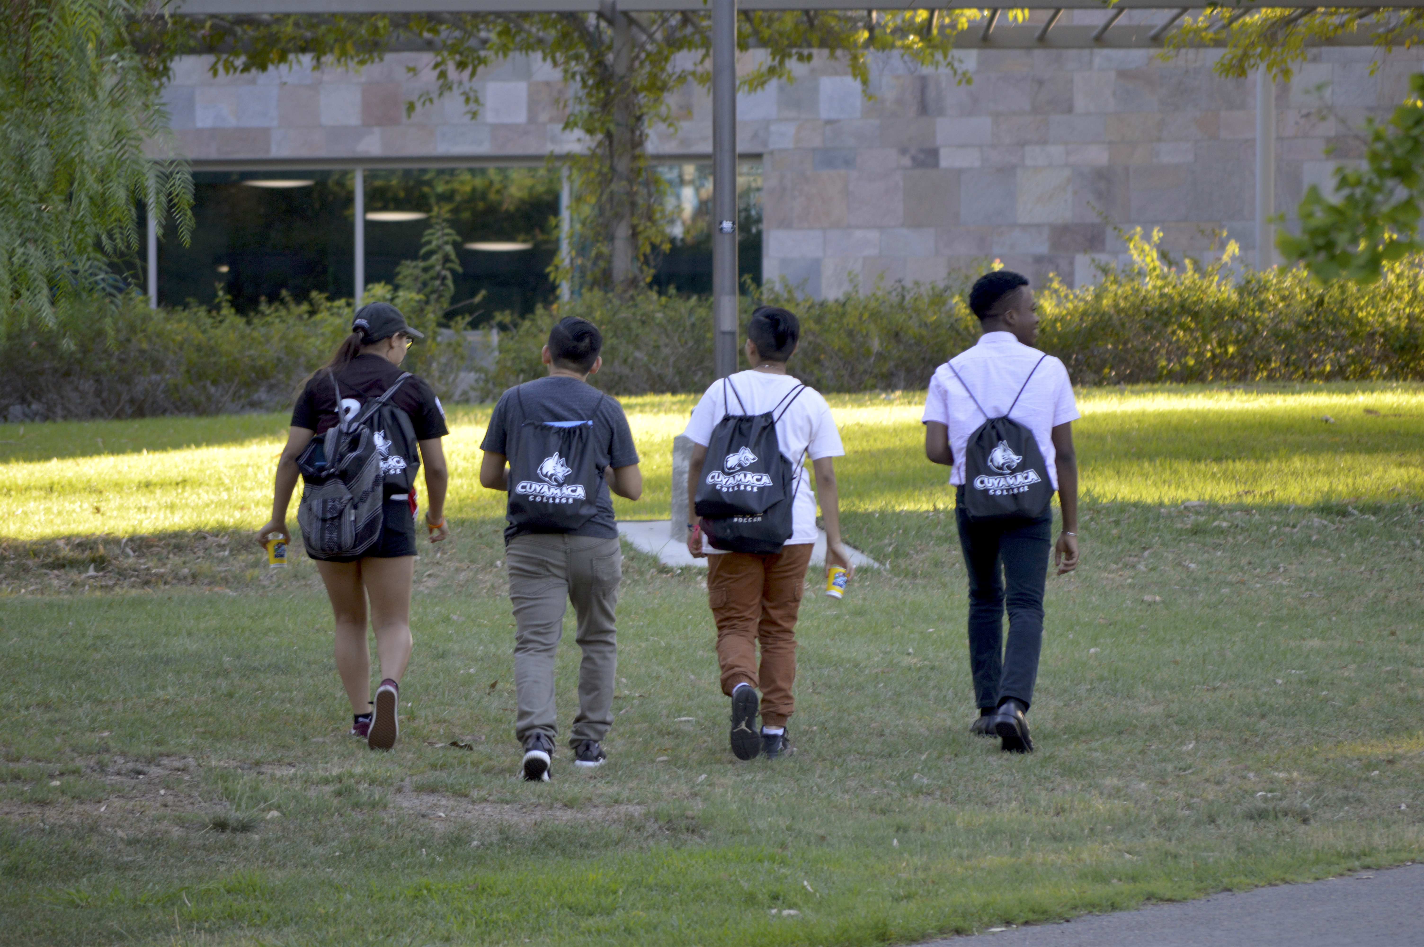
Accreditation
Self-Evaluation and ISER
Bri Hays and Marvelyn Bucky
Presentation to Classified Senate
November 28, 2018

Slide 2
A BRIEF Accreditation 2019 Timeline
Fall 2017
Gap Analysis
Bulleted Outline
Spring 2018
Narrative Drafting
Fall 2018
First Full Draft of ISER
Spring 2019 Final Edits, Vetting, QFE & Front Matter
Summer 2019
Submit ISER to ACCJC

Slide 3
The INSTITUTIONAL Self-Evaluation Report
ISER
Prepared in accordance with the 2014 ACCJC Standards and ACCJC guidelines
4 primary standards with 128 “sub” standards
Evidence-driven responses to how we meet the standards

Slide 4
The accjc standards
Standard I: Mission, Academic Quality and Institutional Effectiveness, and Integrity
Standard II: Student Learning Programs and Support Services
Standard III: Resources
Standard IV: Leadership and Governance

Slide 5
The Quality Focus Essay
2 multi-year initiatives/plans based on self-evaluation findings
Focus on improving student learning and achievement
Progress will be assessed at Mid-Term Report

Slide 6
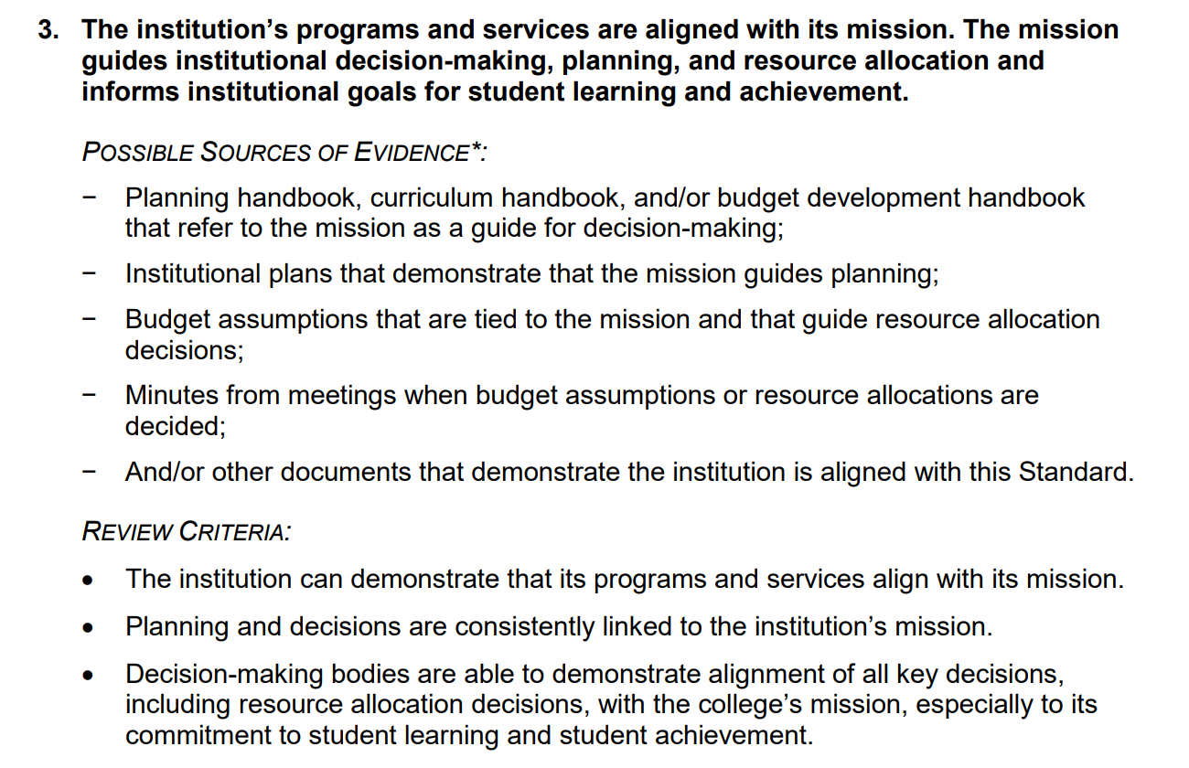
How did we draft responses to the standards?

Slide 7
Timeline for ISER Preparation:
Cuyamaca
Date | Group/Reviewer | Intended Outcome
12/7/2018 | Fall Retreat | First Full Review of ISER
3/19/2019 | Governing Board | First Review of the Draft ISER
4/26/2019 | Campus Forum | Second Full Review of ISER
5/14/2019 | Governing Board | First Full Review of ISER
5/21/2019 | College Council | Final Read/Approval of ISER
6/18/2019 | Governing Board | Final Review/Approval of Final ISER
7/1/2019 | ACCJC | Submission of Final ISER

Slide 8
Which groups have been reviewing ISER responses to date?
Standard | Committee or Council | Vetting Timeline
Standard I | Institutional Effectiveness Committee | October-November 2018
Standard IIA | Curriculum Committee Student Learning Outcome and Assessment Committee Online Teaching and Learning Committee Workforce Development Council Student Success and Equity Committee | September-October 2018 September 2018
Standard IIB | Library Team | Fall 2018
Standard IIC | Student Services Leadership Advisory Team | December 2018
Standard III | Resource and Operations Council | February 2019
Standard IV | College Council Academic Senate Classified Senate ASG | Spring 2019 November 2018-May 2019

Slide 9
How to Provide Feedback: Cuyamaca
Through committees/councils, departments, and the senates
Online feedback forms available via the accreditation webpage
Campus-wide retreat December 7th, 2018

Slide 10

Our Site Visit
Mark your calendars!
September 30th through
October 3rd, 2019

Slide 11
Questions?
Contact Your Accreditation Co-Chairs
Bri Hays
Accreditation Liaison Officer
brianna.hays@gcccd.edu
Marvelyn Buckey
Accreditation Faculty Co-Chair
Marvelyn.buckey@gcccd.edu

