Slide 1
2019-2020 Annual Tech Request Summary
May 1, 2019
College Technology Committee Members: Steve Weinert, Kerry Kilber Rebman (Co-Chairs), Francisco Gonzalez, Patrice Nya, Greg Vega, Corina Trevino, Jodi Reed, Miriam Graf Simpson, Curt Sharon, My-Linh Nguyen, Brian Josephson, Rhonda Bauerlein, Sherri Braaksma, Bryan Cooper

Slide 2
Total Ranking
Requested Item | Funding
DSPS High Tech Center and campus Read and Write Gold 1 | Funded or Pending
DSPS High Tech Center Fusion | Funded or Pending
DSPS High Tech Center Kurzweil | Funded or Pending
All Cornerstone | Funded or Pending
CADD Technology Renewall of Software | Funded or Pending
CIS Wireless Routers and NICS for Network+ class | Funded or Pending
Science and Engineering 3 D Printers | Not Funded
Performing Arts Logic Pro license | Not Funded

Slide 3
Rank 11 - 20
CIS Cable Test devices for Network+ class | Funded or Pending
CIS Fiber Optic Microscopes | Funded or Pending
All EvaluationKit | Not Funded
Performing Arts Finale license | Not Funded
CIS Digital Multimeters for the A+ class | Funded or Pending
Science and Engineering Instructor Laptop for the Earth Science Classroom | Funded or Pending
CIS Webcams for E-205 | Not Funded
Math, Science, and Engineering Instructor Computer | Not Funded
Library Projector for Library Instruction Lab | Funded or Pending
CIS Replace 4 CIS Computer Labs | Funded or Pending

Slide 4
Rank 21-30
Graphic design Multimedia lab | Not Funded
Science & Engineering Support Guided Pathways for Engineering Students | Not Funded
Library Computers for Library Instruction Lab and Reference area | Funded or Pending
CIS Monitor Arms | Not Funded
Graphic design Work experience/internship studio lab | Not Funded
Transfer Multimedia Projector | Not Funded
Instructional Operations New Copier/Scanner/Printer | Funded or Pending
History, Social and Behavioral Sciences R and R Studio Software | Not Funded
Science/Engineering Faculty Office Computer | Not Funded
Mathematics Computer Replacement (Math Computer Lab & Classrooms) | Funded or Pending

Slide 5
Rank 31 - 43
Counseling Computers for front staff | Not Funded
Science & Engineering 82 Promethean Smart Boards (like the ones in F606). | Not Funded
Math, Science, and Engineering Learning Glass for Online Video Content | Not Funded
Math, Science, and Engineering Lab Printer that works | Funded or Pending
Math, Science, and Engineering Classroom response system | Not Funded
ART MAC computer | Not Funded
Library computer projector | Funded or Pending
Math NetSupport License for Math Computer Lab | Not Funded
Library computers | Not Funded
CIS Replace computers in E-206, E-210, E-211 (A+), and E-213 (cabling) | Not Funded
General Counseling Grade Master Scanner & Updating Software for A-112 Desktop Computer | Not Funded
Performing Arts Mac for Music Technician | Not Funded
Math, Science, and Engineering Physics - Demonstration Camera | Not Funded

Slide 6
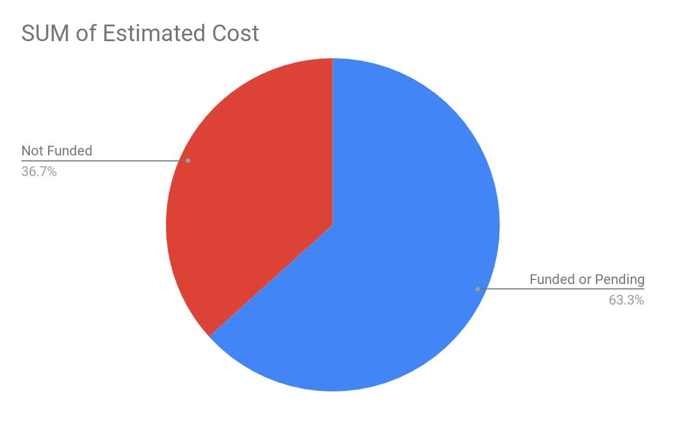
Requests funded - or pending funding

Slide 7
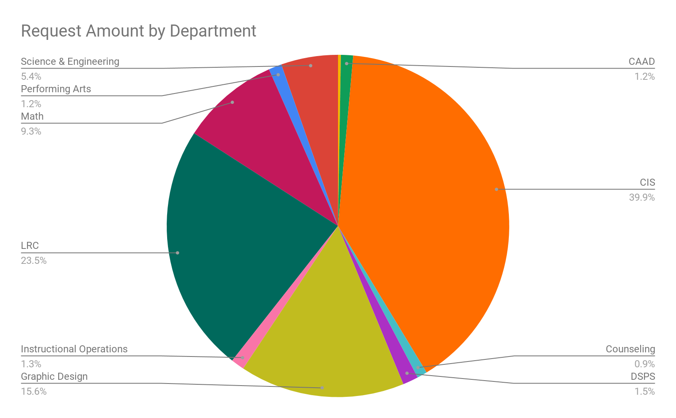
Request by Department
Who | SUM of Estimated Cost
 | 0.00
ART | 2,000.00
CAAD | 8,500.00
CIS | 294,797.00
Counseling | 7,000.00
DSPS | 10,850.00
Graphic Design | 115,000.00
HSBS | 0.00
Instructional Operations | 9,330.00
LRC | 173,638.64
Math | 68,535.93
Performing Arts | 9,100.00
Science & Engineering | 39,664.74
Grand Total | 738,416.31

Slide 8
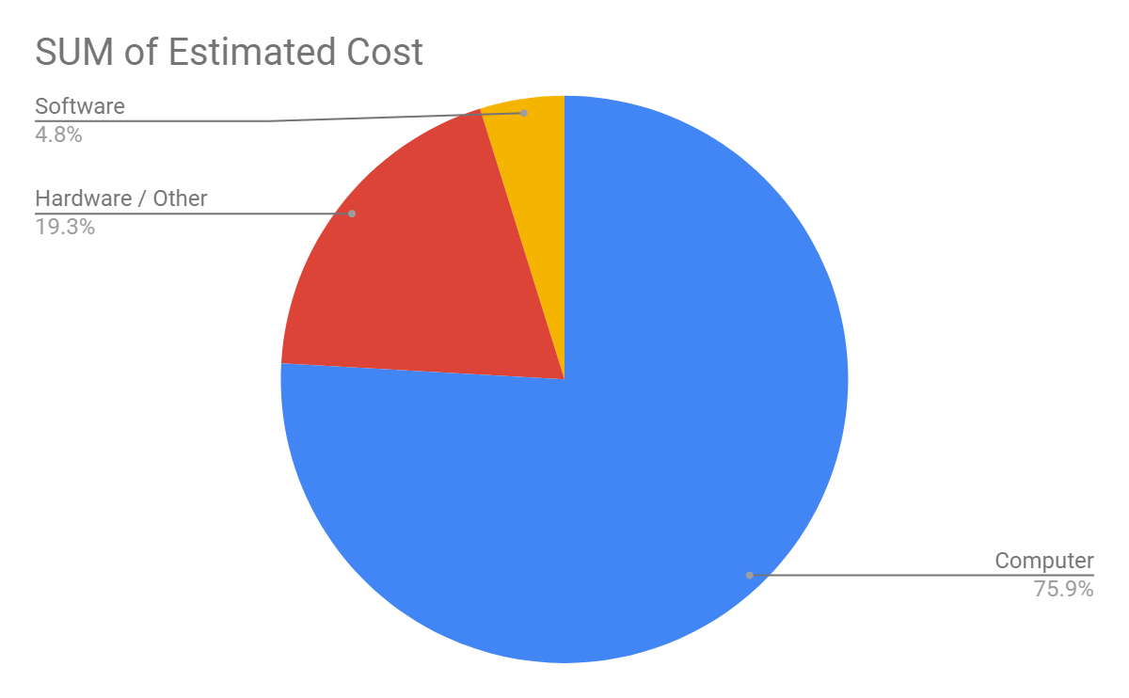
Areas of Need
Computer / software / hardware | SUM of Estimated Cost
Computer | 560,454.74
Hardware / Other | 142,409.32
Software | 35,552.25

Slide 9
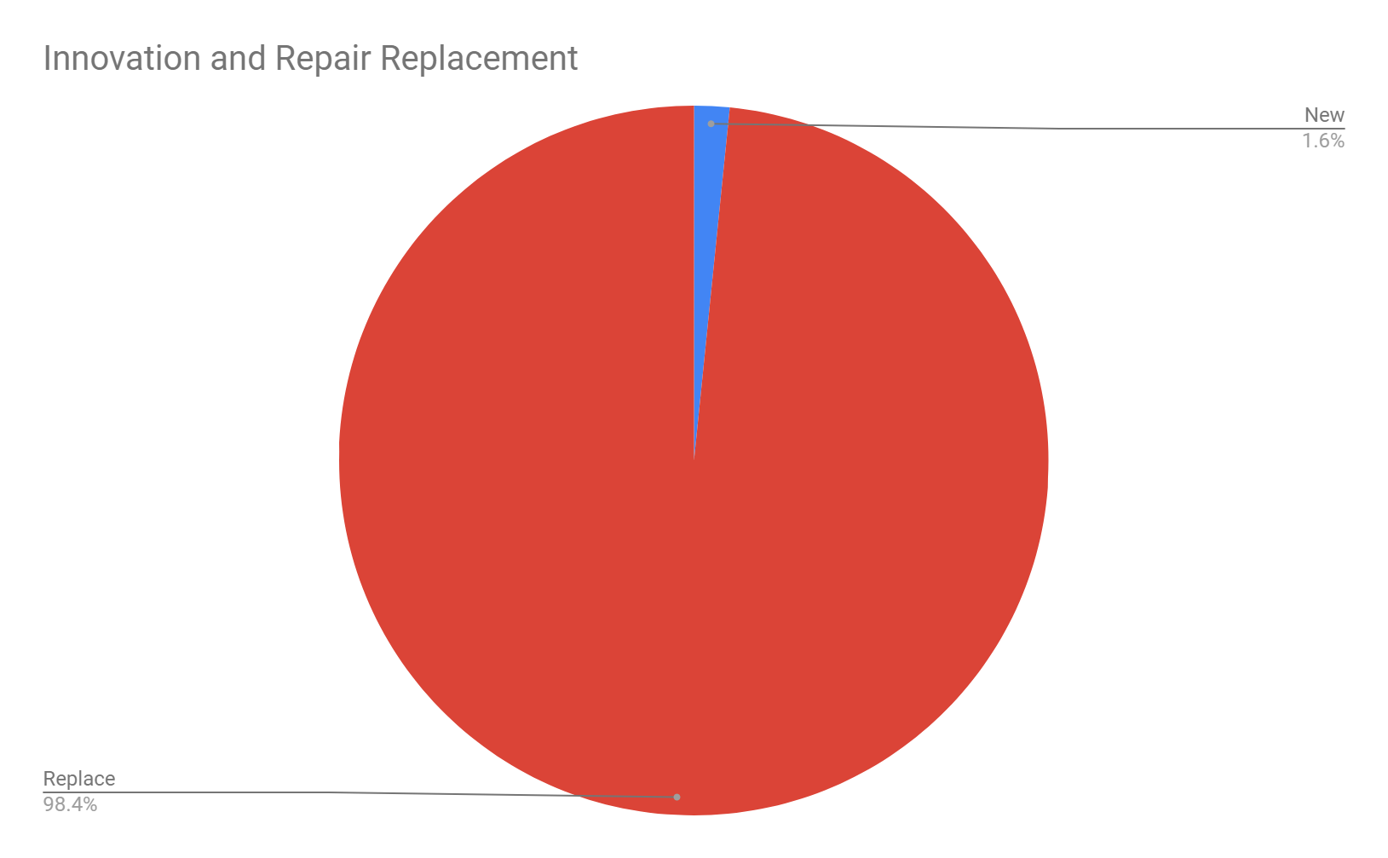
Innovation!
Replace/ New | SUM of Estimated Cost
New | 11,895.00
Replace | 726,521.31

